Slide 1
Bank Loan Stats
April 2022 Update

Slide 2
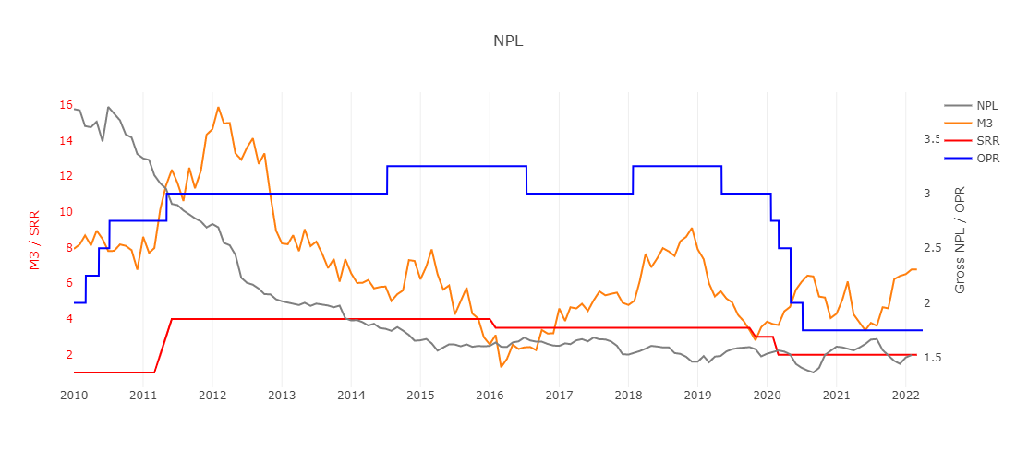
Overview of Bank Loan Stats
M3 is higher YoY; while Non-performing Loan (NPL) is lower YoY.

Slide 3
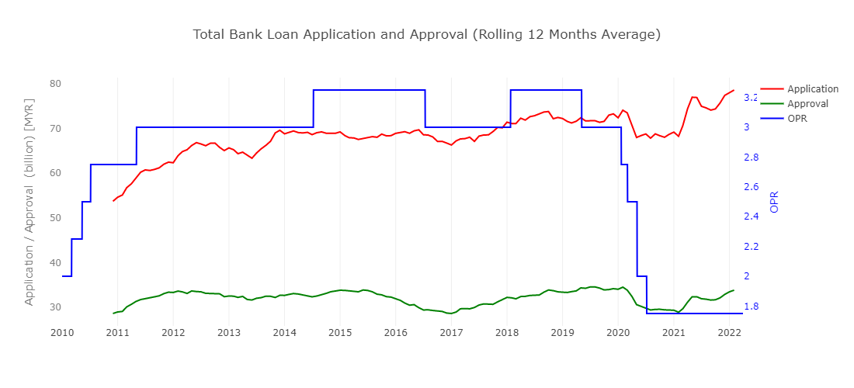
Total Bank Loan Application and Approval
Total bank loan application and approval amounts have improved YoY
from 59.0B to 66.7B and 24.5B to 28.9B, respectively, as of Feb 2022.

Slide 4
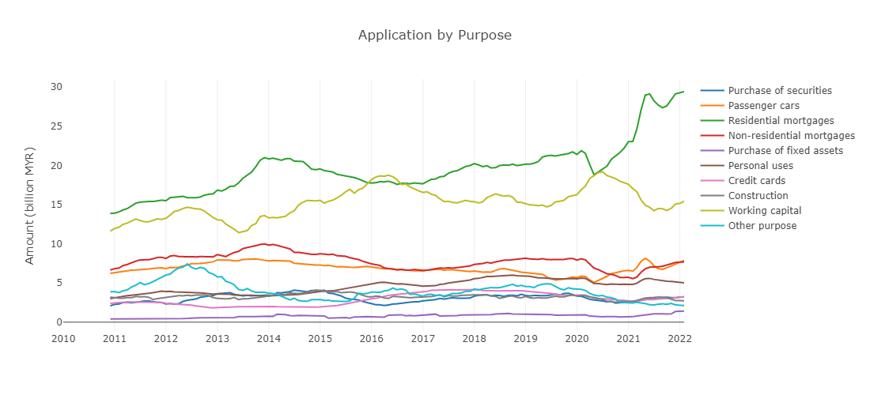
Loan Application by Purpose (Rolling 12 Months Average)

Slide 5
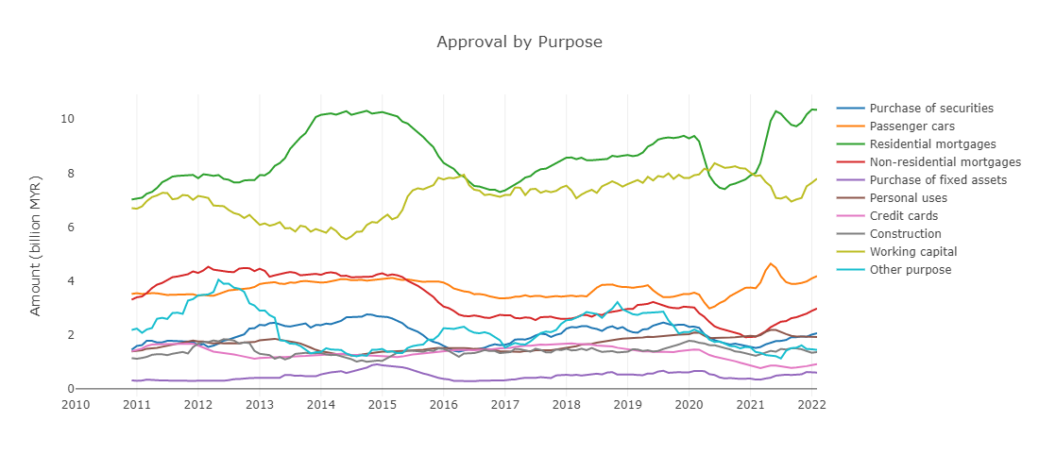
Loan Approval by Purpose (Rolling 12 Months Average)

Slide 6
YoY% Change in Loan Application and Approval
Loan Application | Nov21-YoY | Dec21-YoY | Jan22-YoY | Feb22-YoY |  | Loan Approval | Nov21-YoY | Dec21-YoY | Jan22-YoY | Feb22-YoY
Passenger cars | 32.77 | 32.9 | 47.56 | 45.13 |  | Credit cards | 23.66 | 36.57 | 63.53 | 62.93
Credit cards | 8.6 | 17.46 | 29.7 | 38.93 |  | Non-residential mortgages | 39.05 | 31.62 | 51.69 | 49.34
Working capital | 22.35 | 56.74 | 8.08 | 29.35 |  | Purchase of securities | 16.91 | -8.67 | 72.28 | 47.07
Purchase of securities | -18.1 | -6.46 | 36.87 | 17.63 |  | Construction | -21.25 | -48.35 | -38.93 | 43.33
Non-residential mortgages | 33.56 | 29.82 | 1.3 | 11.18 |  | Working capital | 8.25 | 66.41 | 30.49 | 36.11
Residential mortgages | 36.09 | 33.79 | 6.45 | 8.54 |  | Passenger cars | 7.53 | 14.59 | 33.94 | 31.21
Personal uses | -6.31 | -9.64 | -13.17 | -15.25 |  | Residential mortgages | 16.66 | 37.85 | 25.27 | -1.82
Purchase of fixed assets | 16.81 | 577.04 | 66.79 | -16.07 |  | Personal uses | 1.1 | -0.43 | 3.13 | -11.23
Other purpose | 104.54 | -73.7 | -37.41 | -16.39 |  | Purchase of fixed assets | 87.79 | 250.57 | -38.01 | -18.39
Construction | -50.83 | -47.45 | 2.77 | -18.17 |  | Other purpose | 74.05 | -61.7 | -7.24 | -60.24
Loan Application and Approval for credit cards and passenger cars YoY numbers remained strong. Residential mortgages approval decreased slightly by 1.82% YoY.

Slide 7
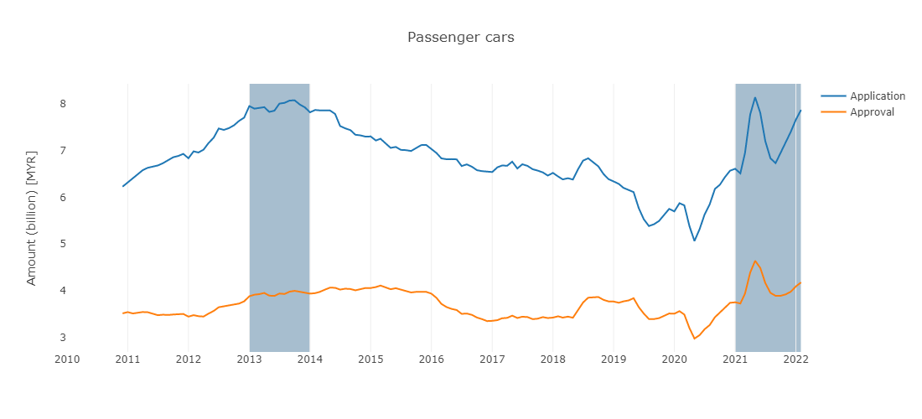
Passenger Car Loans
Both loan application and approval are on a rising trend since 2020 March.
Both amounts are near the peaks of 2013/14.

Slide 8
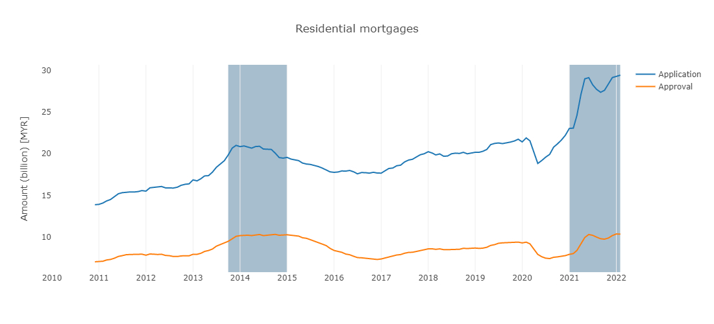
Residential Mortgages
Both loan application and approval amounts are above/near the peak of 2014 and on a rising trend.

Slide 9
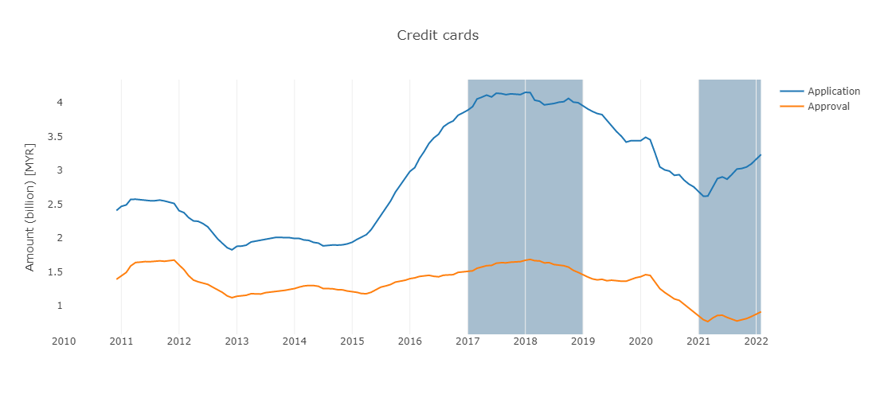
Credit Cards
Credit cards loan stat is a good indicator of consumer sentiment.
The latest trend for application and approval rebounded from the lows in early 2021, and are currently on the rise.

